Slide 1


Mastering Azure Databricks
Trainer: Maruti Makwana

Slide 2
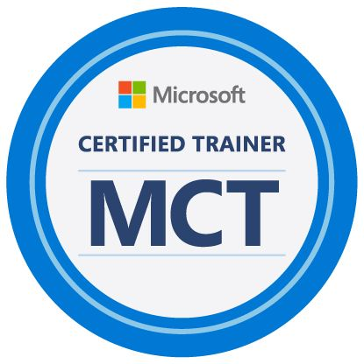
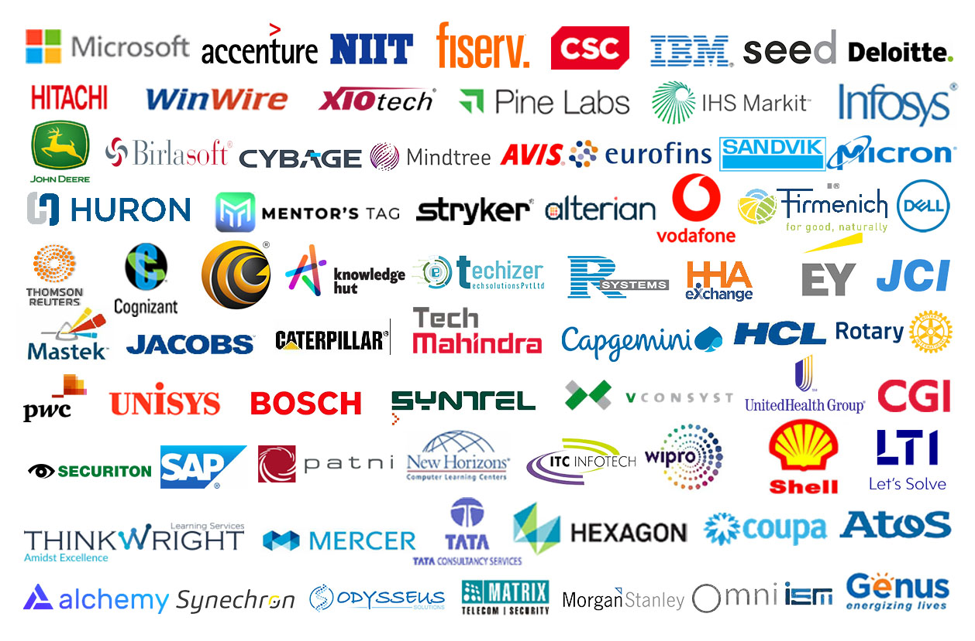
Maruti Makwana www.mentorsTAG.com

Slide 3
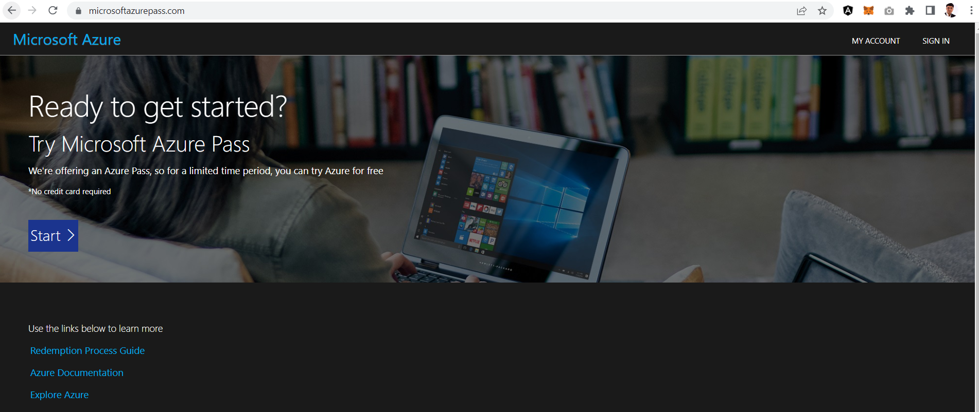
Prerequisites and Lab Access
Get your
Azure Subscription
Using Azure Pass
Microsoft Azure Fundamentals
Azure Storage Account
Basics of SQL Server [Tables/Queries]
Reference Links
https://learn.microsoft.com/en-us/training/modules/explore-relational-data-offerings/
https://learn.microsoft.com/en-us/training/modules/explore-provision-deploy-relational-database-offerings-azure/
https://learn.microsoft.com/en-us/training/modules/explore-provision-deploy-non-relational-data-services-azure/

Slide 4
Azure Storage
DWH
Scaling
Data Factory
Spark
Databricks
Cluster
Secret
Delta Lake
Data Lake
Pipeline
Unity Catalog
Dataframe
Delta live table
Notebooks
ETL

Slide 5
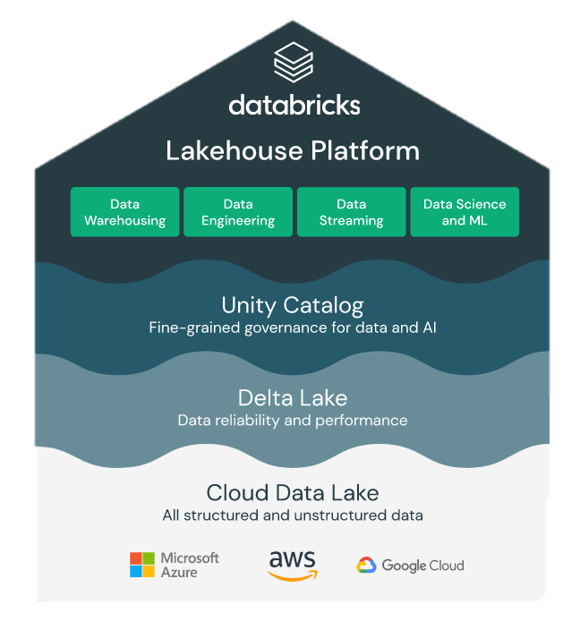
What is Databricks?
Databricks is an open and unified platform for data engineering, machine learning and analytics. It combines Data warehouse and data lakes into a LakeHouse Architecture.
https://databricks.com/product/data-lakehouse

Slide 6
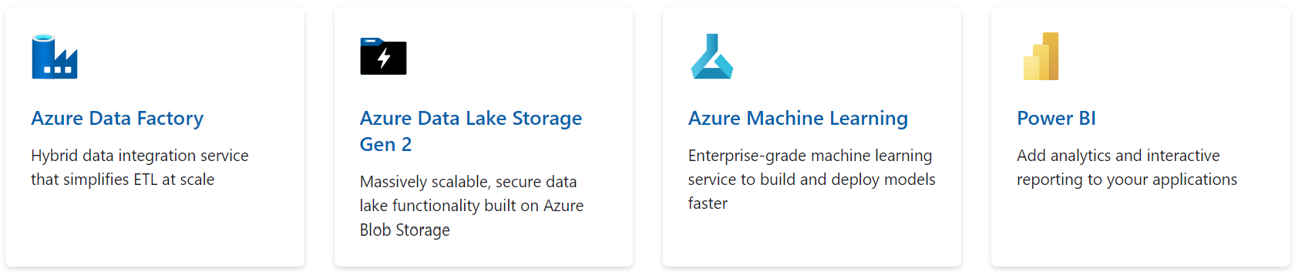
What is Azure Databricks?
Scale
High Availability
Integrations
Distributed file systems
Security
Spark
Delta lake
Python, R, SQL, Scala
Notebooks

Slide 7
What is Spark?
Apache Spark is a sophisticated distributed computation framework for executing code in parallel across many different machines.
Spark uses clusters of machines to process big data by breaking a large task into smaller ones and distributing the work among several machines
Below diagram represents how Spark uses different components to coordinate work across a cluster of computers
Driver
Executor
Executor
Executor
Task
Task
Task
Task
Task
Task

Slide 8
What is Spark?
Driver
The driver is the machine in which application runs. It is responsible for 3 main things :
Maintaining information about the spark application
Responding to user’s program
Analyzing, distributing and scheduling work across the executors
Executors
Each executor will hold the chunk of the data to be processed. This chunk is called partition. It is a collection of rows that sits on one physical machine in the cluster. The executors are responsible for carrying out the work assigned
by the driver. Each executor is responsible for 2 things
Execute the code assigned by driver
Report the state of the computation back to the driver
Task
Tasks are created by the driver and assigned a partition of data to process. A partition is a collection of rows
That sits on one physical machine in your cluster. Then tasks are assigned to slots for parallel execution.
Once started each task will fetch its assigned partition from the original data source

Slide 9
Azure Databricks Components
Cluster
A set of computation resources and configurations on which you run notebooks and jobs. There are two types of clusters: all-purpose and job.
You create an all-purpose cluster using the UI, CLI, or REST API. You can manually terminate and restart an all-purpose cluster. Multiple users can share such clusters to do collaborative interactive analysis.
The Azure Databricks job scheduler creates a job cluster when you run a job on a new job cluster and terminates the cluster when the job is complete. You cannot restart an job cluster.
Pool
A set of idle, ready-to-use instances that reduce cluster start and auto-scaling times. When attached to a pool, a cluster allocates its driver and worker nodes from the pool. If the pool does not have sufficient idle resources to accommodate the cluster’s request, the pool expands by allocating new instances from the instance provider. When an attached cluster is terminated, the instances it used are returned to the pool and can be reused by a different cluster.
Job
A non-interactive mechanism for running a notebook or library either immediately or on a scheduled basis.

Slide 10
Azure Databricks Components
Workspaces
A workspace is an environment for accessing all of your Azure Databricks assets. A workspace organizes objects (notebooks, libraries, dashboards, and experiments) into folders and provides access to data objects and computational resources.
Notebook
A web-based interface to documents that contain runnable commands, visualizations, and narrative text.
Library
A package of code available to the notebook or job running on your cluster. Databricks runtimes include many libraries and you can add your own.
Databricks File System (DBFS)
A filesystem abstraction layer over a blob store. It contains directories, which can contain files (data files, libraries, and images), and other directories. DBFS is automatically populated with some datasets that you can use to learn Azure Databricks.

Slide 11
What is DBFS?
The Databricks File System (DBFS) is a distributed file system mounted into an Azure Databricks workspace and available on Azure Databricks clusters.
What can you do with DBFS?
DBFS provides convenience by mapping cloud object storage URIs to relative paths.
Allows you to interact with object storage using directory and file semantics instead of cloud-specific API commands.
Simplifies the process of persisting files to object storage, allowing virtual machines and attached volume storage to be safely deleted on cluster termination.
Provides a convenient location for storing init scripts, JARs, libraries, and configurations for cluster initialization.
Provides a convenient location for checkpoint files created during model training with OSS deep learning libraries.

Slide 12
https://learn.microsoft.com/en-us/azure/databricks/getting-started/concepts

Slide 13
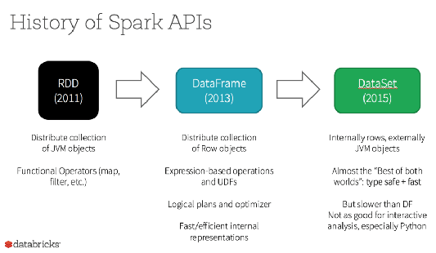
What is RDD?
RDD was the primary user-facing API in Spark since its inception. At the core, an RDD is an immutable distributed collection of elements of your data, partitioned across nodes in your cluster that can be operated in parallel with a low-level API that offers transformations and actions.

Slide 14
Cloud Models
Public cloud:
No capital expenditures to scale up.
Applications can be quickly provisioned and deprovisioned.
Organizations pay only for what they use.
Private cloud:
Organizations have complete control over resources.
Organizations have complete control over security.
Hybrid cloud:
Most flexibility.
Organizations determine where to run their applications.
Organizations control security, compliance, or legal requirements.

Slide 15
IAAS – PAAS - SAAS
On-Premises
( Private Cloud )
Infrastructure
( as a Service )
Platform
( as a Service )
Software
( as a Service )
Data & Access
Data & Access
Data & Access
Data & Access
Applications
Applications
Applications
Applications
You Manage
Runtime
Runtime
Runtime
Runtime
Cloud Provider Manages
Operating System
Operating System
Operating System
Operating System
Virtual Machine
Virtual Machine
Virtual Machine
Virtual Machine
Compute
Compute
Compute
Compute
Networking
Networking
Networking
Networking
Storage
Storage
Storage
Storage

Slide 16
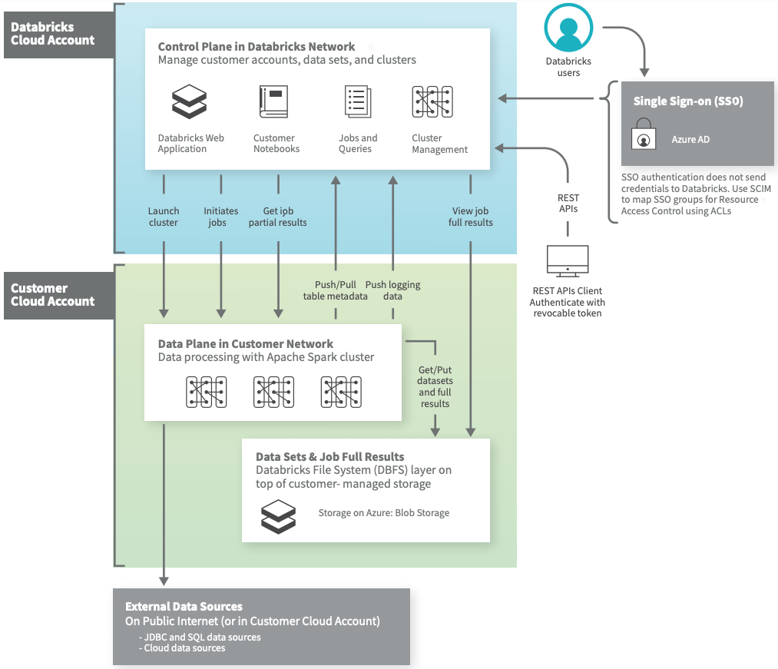
Azure Databricks Architecture
Azure Databricks operates out of a control plane and a data plane.
→The control plane includes the backend services that Azure Databricks manages in its own Azure account. Notebook commands and many other workspace configurations are stored in the control plane and encrypted at rest.
→The data plane is managed by your Azure account and is where your data resides. This is also where data is processed. You can use Azure Databricks connectors so that your clusters can connect to external data sources outside of your Azure account to ingest data or for storage. You can also ingest data from external streaming data sources, such as events data, streaming data, IoT data, and more.

Slide 17
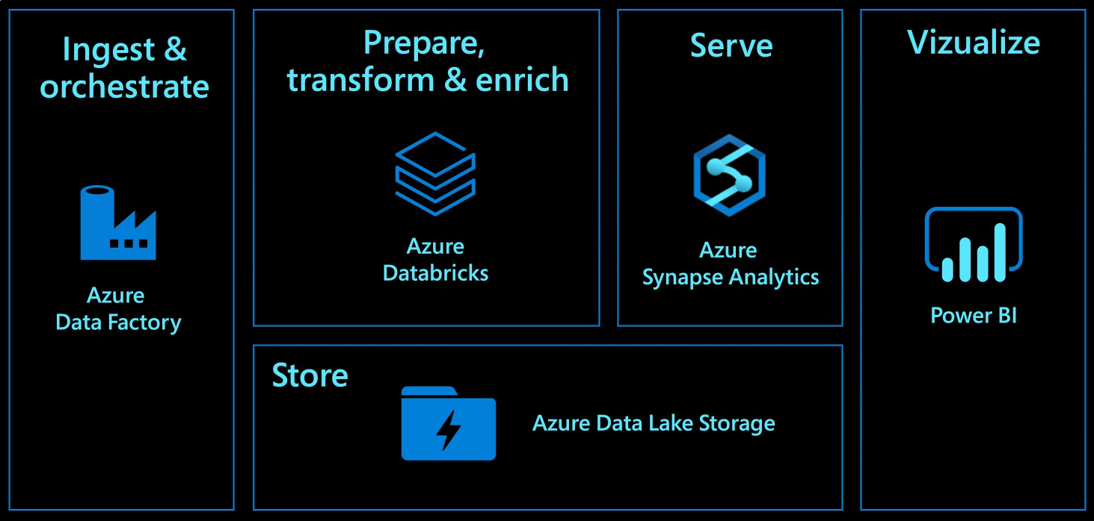
End to End Data Analytics

Slide 18
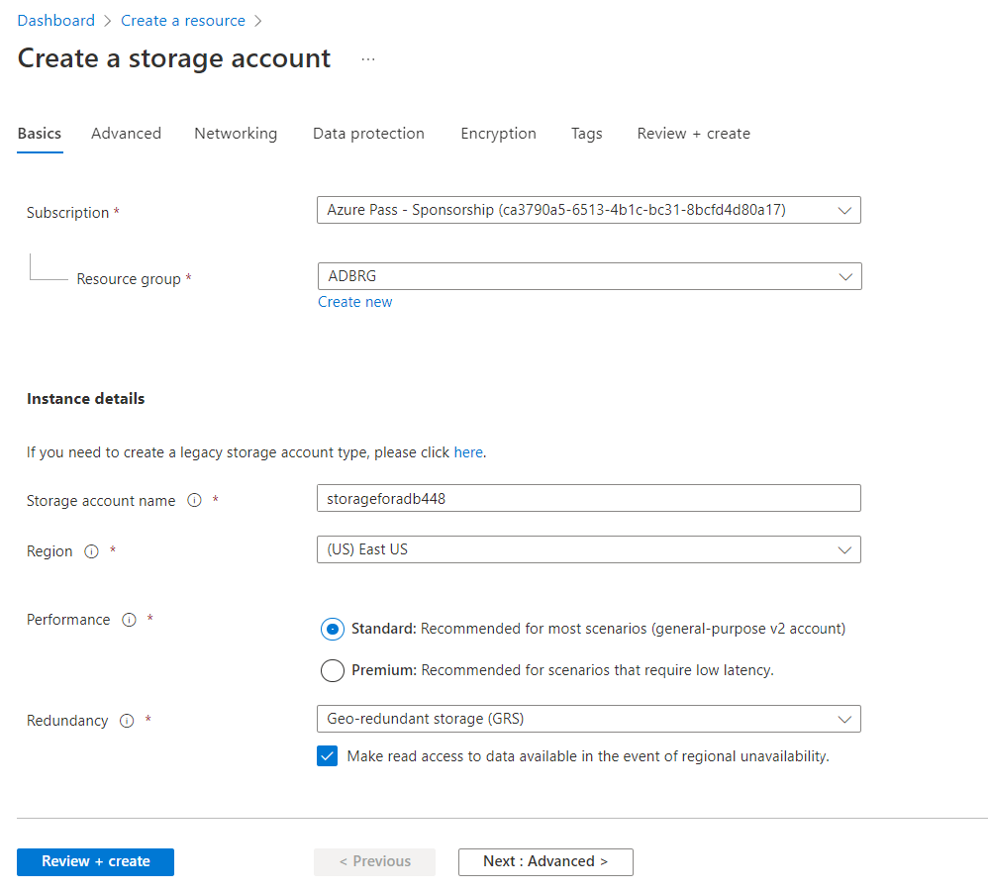

Slide 19
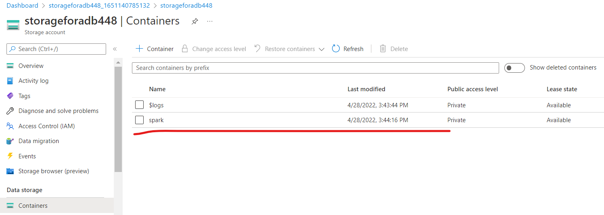
Create container with name spark

Slide 20
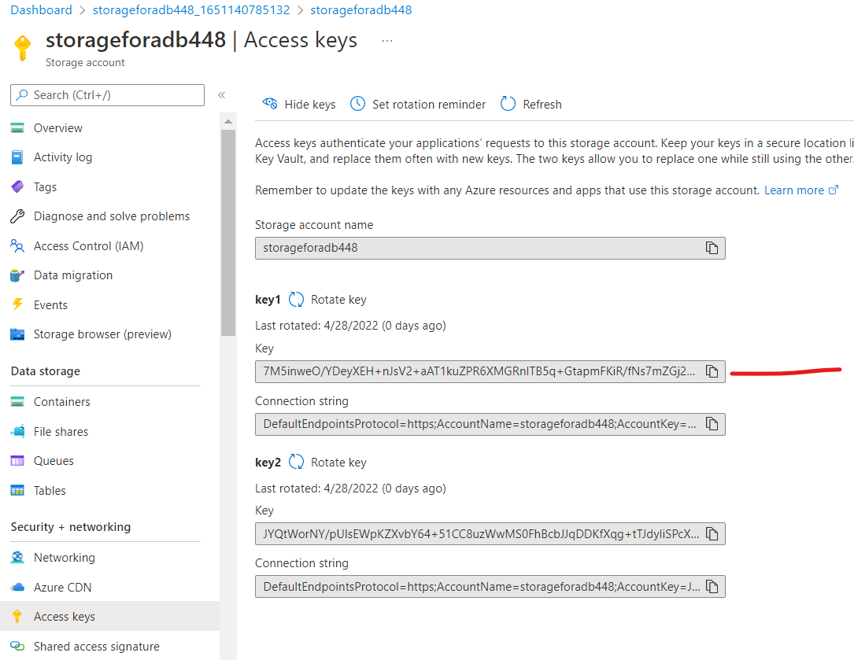

Slide 21
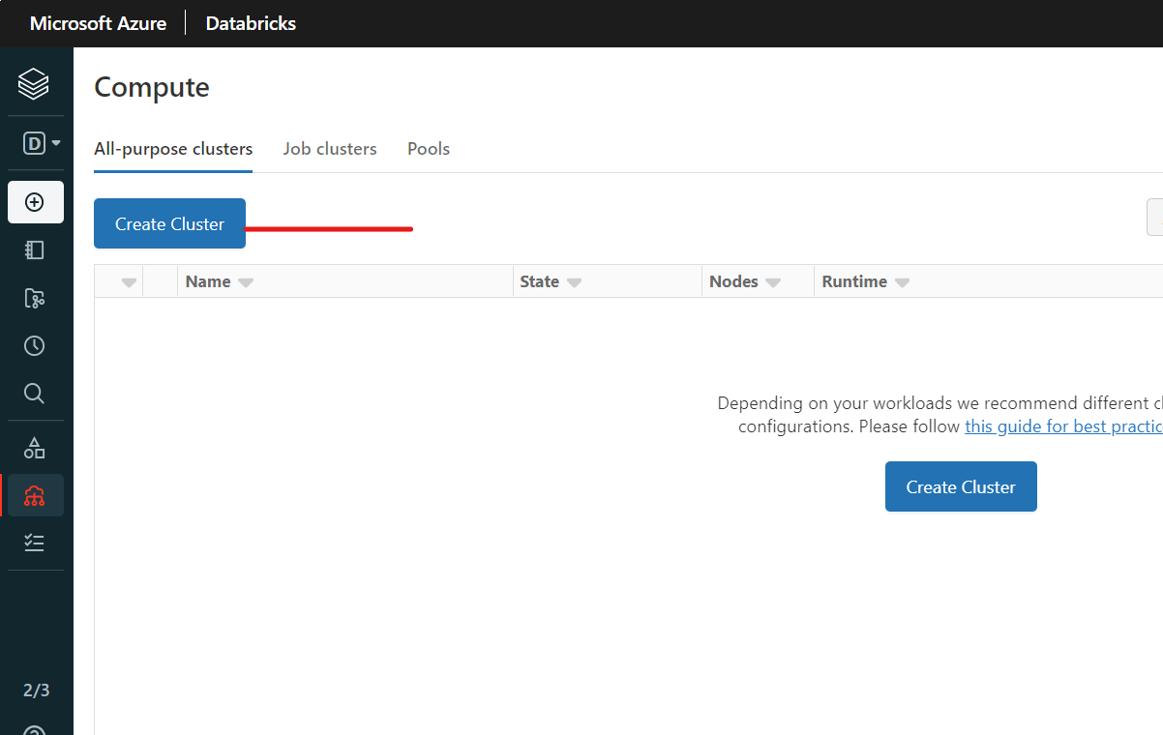

Slide 22
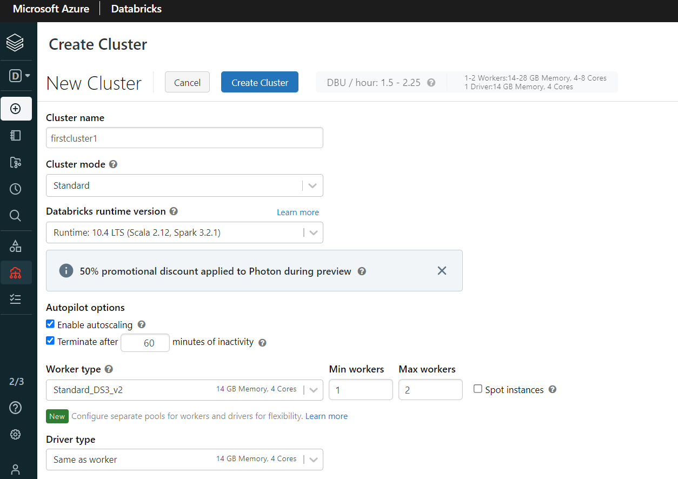

Slide 23
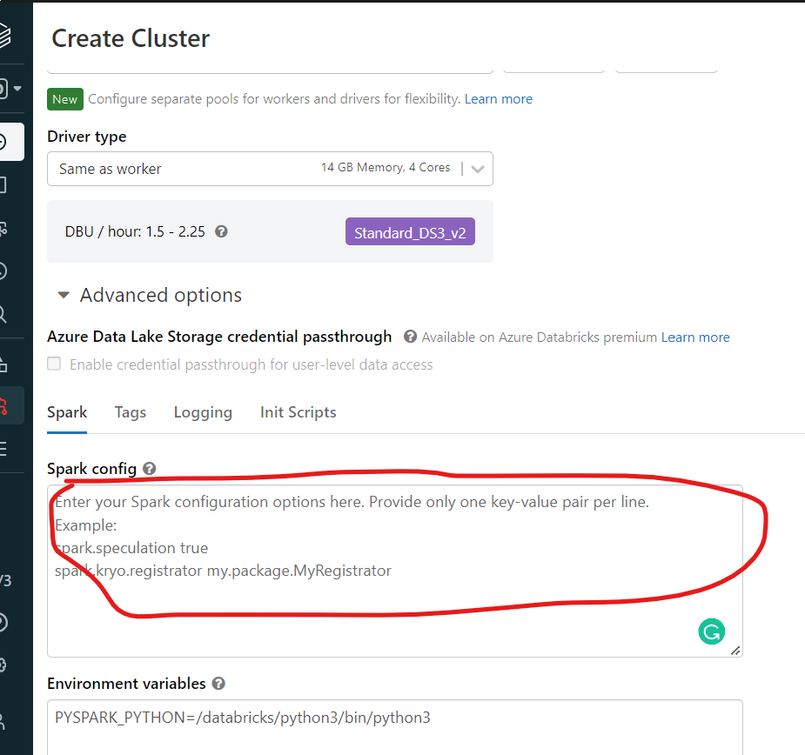
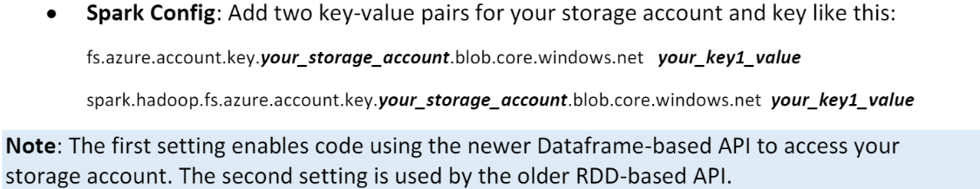

Slide 24
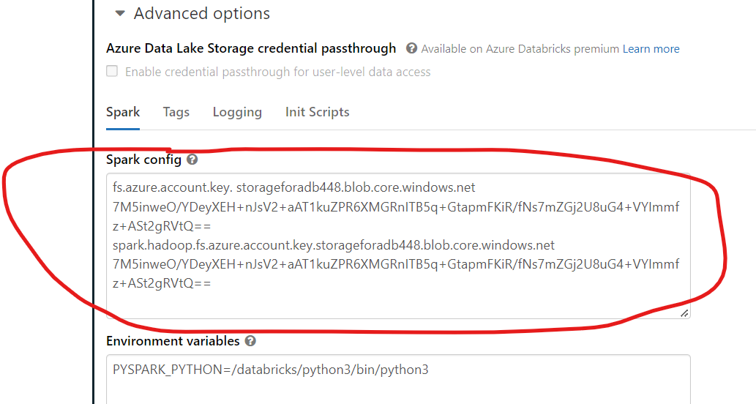

Slide 25
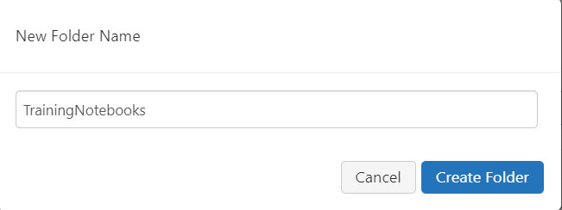

Slide 26
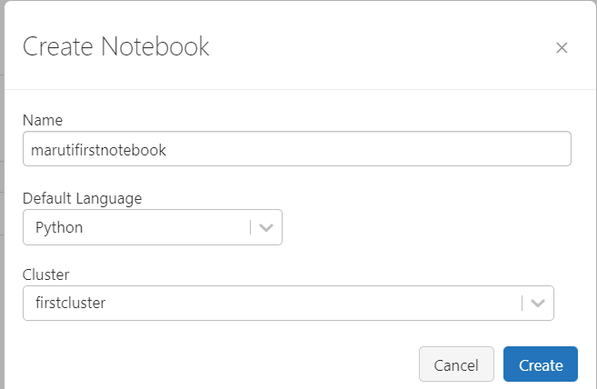

Slide 27
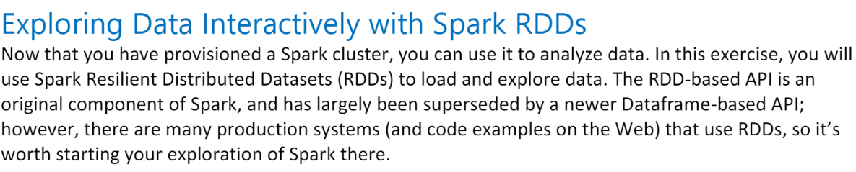

Slide 28
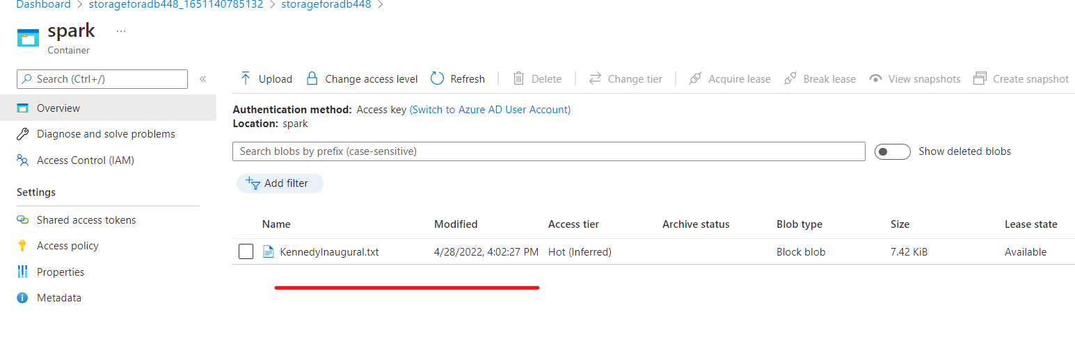

Slide 29
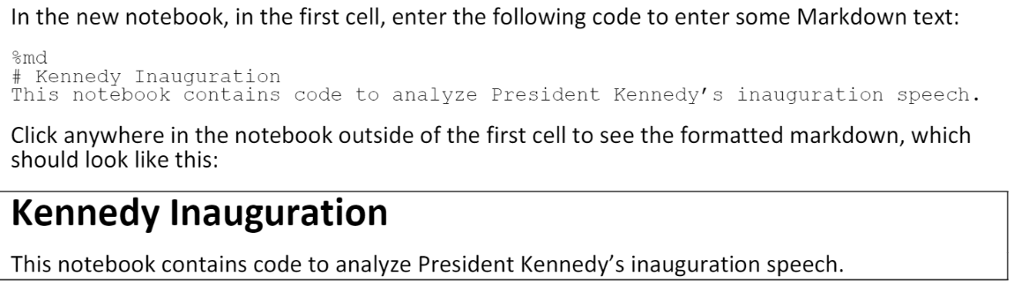
%md
# Kennedy Inaugrations
This notebook containes code to analyze President Kennedy's inauguration speech.

Slide 30
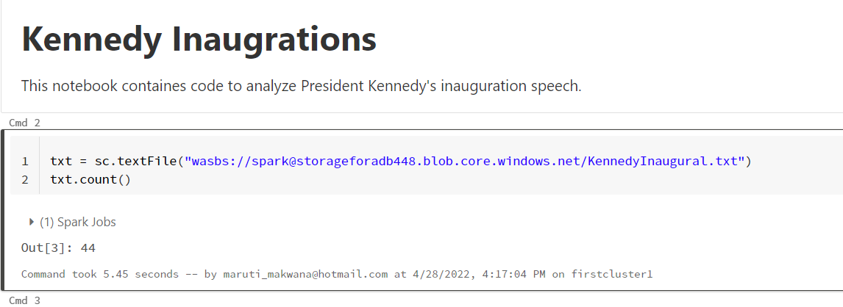
txt = sc.textFile("wasbs://spark@storageforadb448.blob.core.windows.net/KennedyInaugural.txt")
txt.count()
Sc is spark context which is created automatically

Slide 31
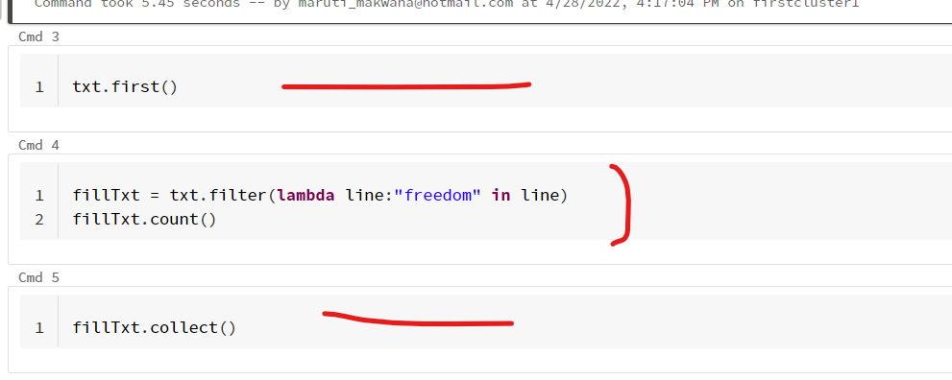

Slide 32
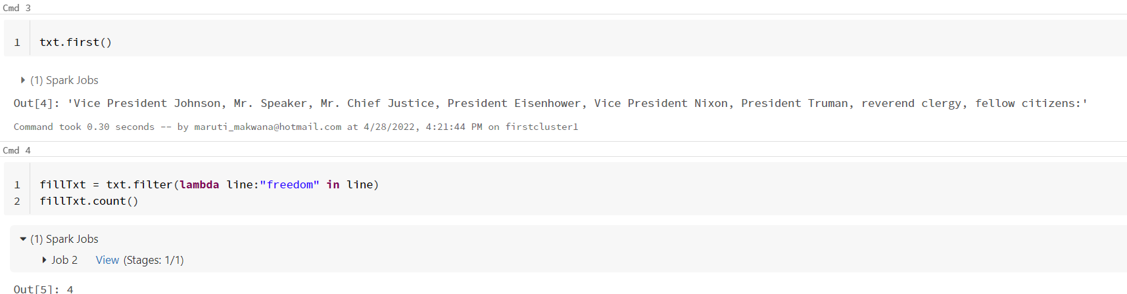

Slide 33
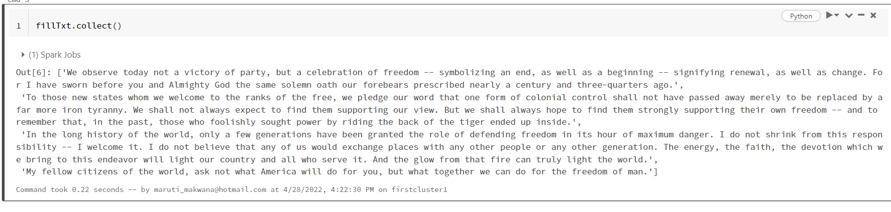

Slide 34
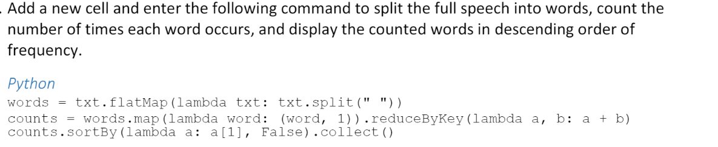

Slide 35
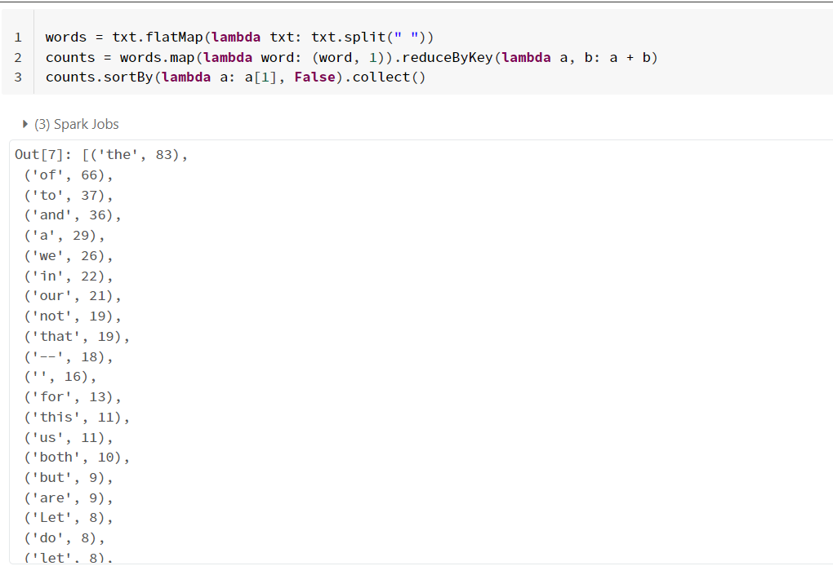

Slide 36
txt = sc.textFile("wasbs://spark@storageforadb448.blob.core.windows.net/KennedyInaugural.txt")
txt.count()
txt.first()
fillTxt = txt.filter(lambda line:"freedom" in line)
fillTxt.count()
fillTxt.collect()
words = txt.flatMap(lambda txt: txt.split(" "))
counts = words.map(lambda word: (word, 1)).reduceByKey(lambda a, b: a + b)
counts.sortBy(lambda a: a[1], False).collect()

Slide 37
Working with Dataframes

Slide 38
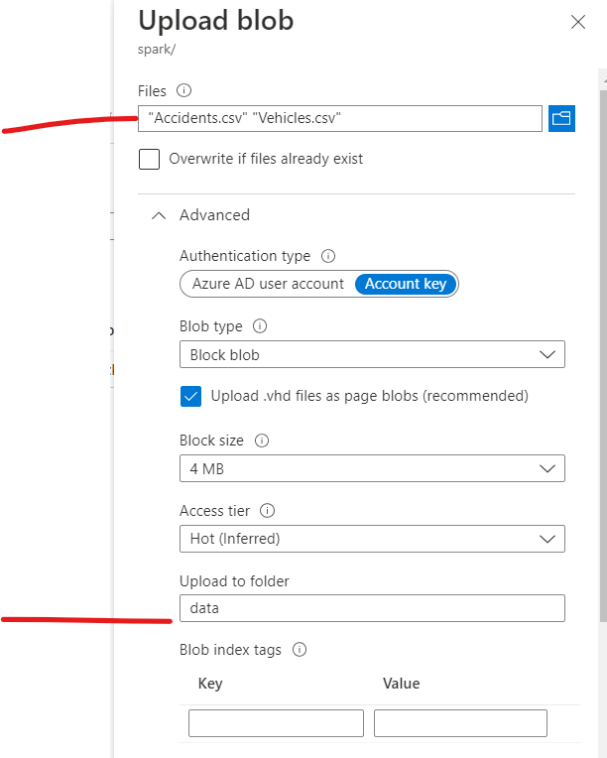

Slide 39
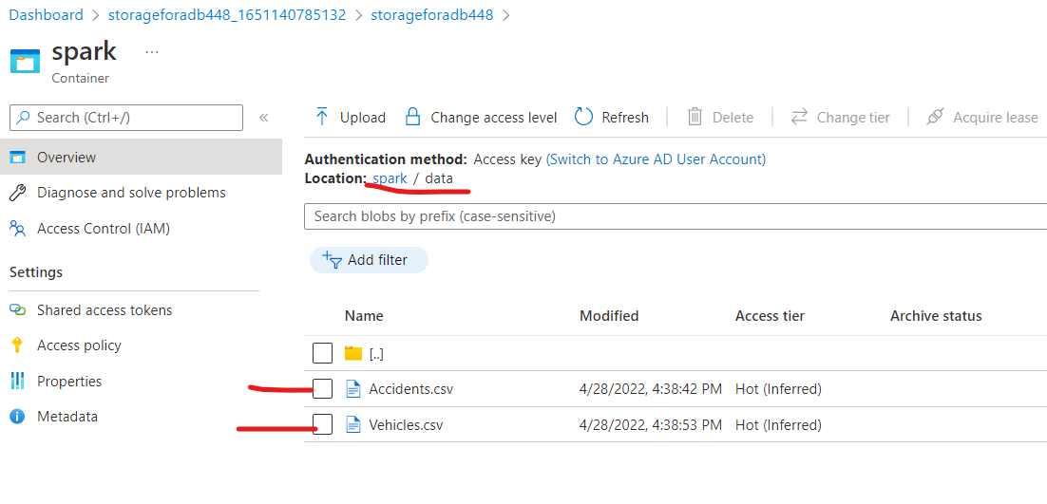

Slide 40
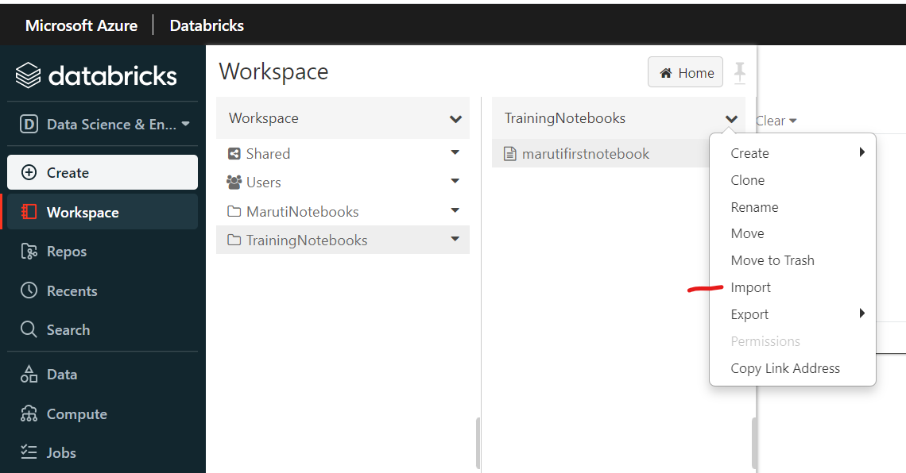

Slide 41
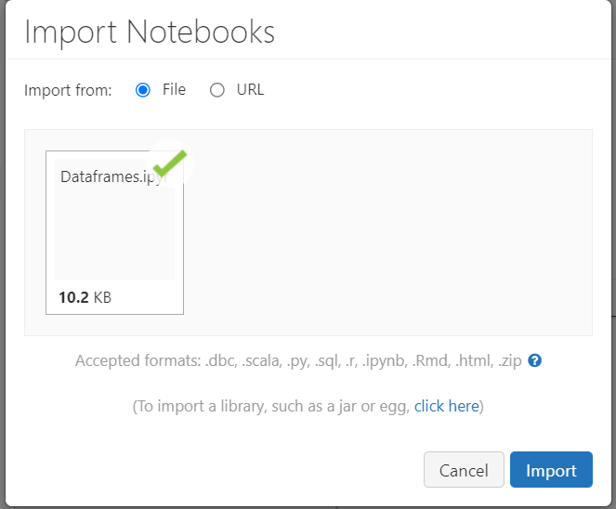

Slide 42
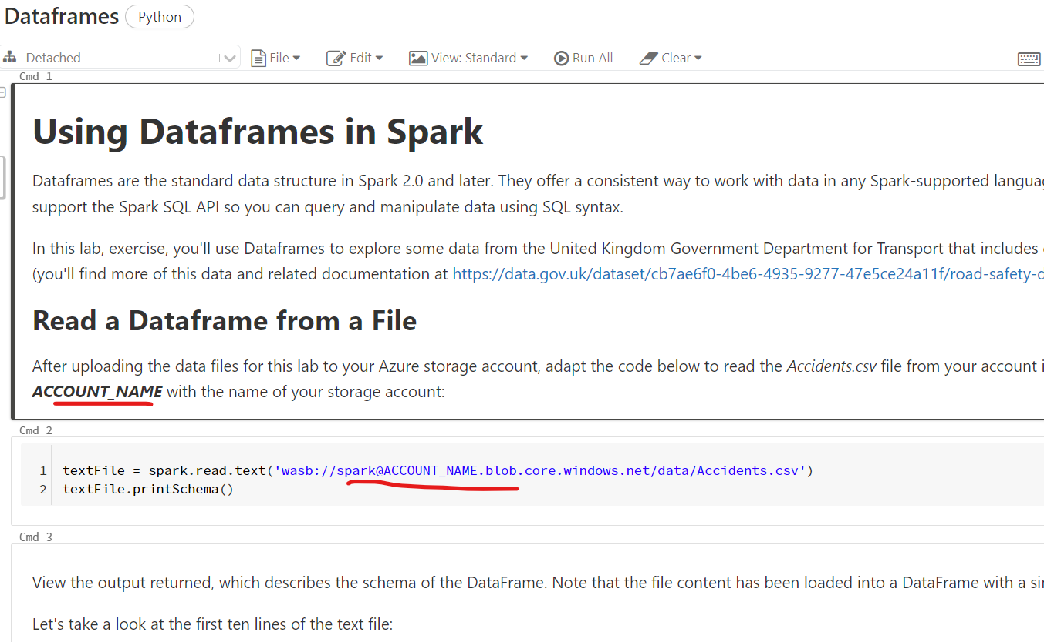

Slide 43
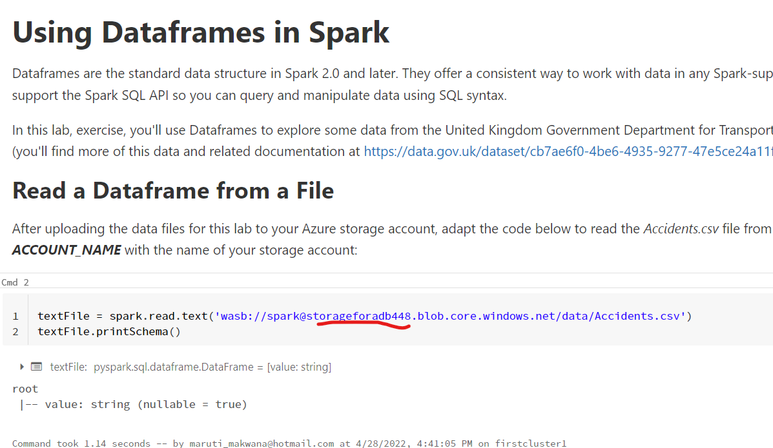

Slide 44
Click Run All in the notebook to execute all the cells at once

Slide 45
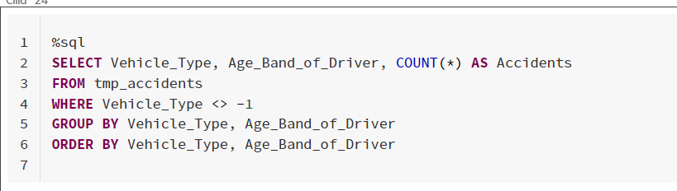
Scroll down to Cmd24

Slide 46
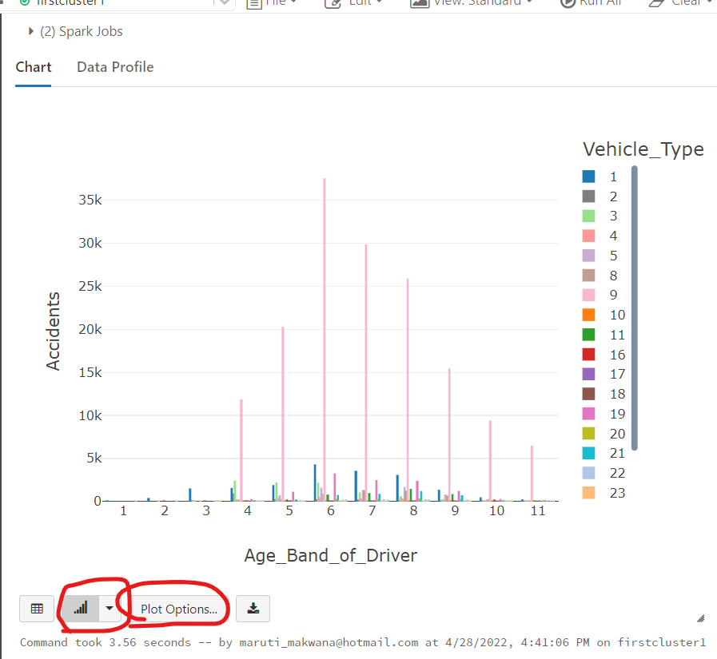

Slide 47
